Slide 1
An introduction to Secure by Design
[ADD YOUR ORGANISATION HERE]
Notes:
The purpose of this session is to provide an overview of the cross-govt Secure by Design approach and discuss questions and feedback
Please note that there is a Q&A paper also available
The launch of the approach was announced by the Deputy Prime Minister at the govt cyber security conference in December 2023 and is now being rolled out across central government in two phases, starting with
ministerial departments
arm’s length bodies (ALBs) managing government Critical National Infrastructure (CNI) and organisations managing priority government services (top 75 services).

Slide 2
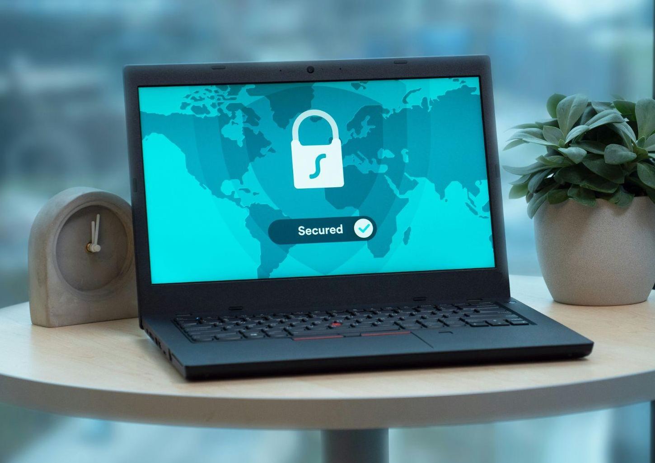
About Secure by Design
    Improves cyber resilience across government organisations
Incorporates cyber security practices throughout the digital delivery lifecycle
Find out more at
security.gov.uk/guidance/secure-by-design
    Highlights cyber security risks as business risks and makes security everyone’s responsibility
Notes:
Secure by Design aims to:
Enhance our cyber resilience and data sharing across government by establishing a common, risk-driven approach for integrating protective controls into digital services from the outset and throughout their delivery.
Embedding effective cyber security practices throughout digital delivery by enforce mandatory principles and best practice activities covering every stage of the digital delivery lifecycle. This approach spans from the development of business cases to the transition of services from project delivery to business-as-usual.
Cultivate a shared responsibility for security by fostering a culture where security is a collective responsibility, not just the domain of the security team. Ensure that project and delivery teams actively manage security risks at the appropriate level throughout the digital delivery process.

Slide 3

The benefits
    Increases collaboration between security and delivery teams
    Creates a positive security culture and upskills non-security teams
    Promotes the use of appropriate and proportionate security controls
    Shifts focus from point-in-time assurance to continuous security
Find out more at
security.gov.uk/guidance/secure-by-design
    Helps organisations achieve Cyber Assurance Framework outcomes
Notes:
Cabinet Office / CDDO went through extensive discovery and analysis with input from a cross government working group to understand the problem space and agree the core benefits. This approach aims to bring a number of significant benefits including:
Improves collaboration between digital and security colleagues and cultivates a positive security culture - the approach provides an example RACI matrix which suggests who should be involved in the Secure by Design activities. Clear security responsibilities for the various roles in project/delivery teams will support colleagues develop an elevated security mindset and encourage everyone being part of a positive security culture. Contributes to the upskilling of non-security professionals with the practical guidance on how to do security activities, supported by templates, examples and tools
Introduces consistent approach to Secure by Design, providing clear expectations and simplifying the process for project teams to understand and implement appropriate and proportionate security measures. Hopefully, this predictability will reduce confusion and uncertainty. Consistency doesn’t mean rigidity. The approach provides a solid foundation but allows for adaptability, as deviations in the Activities can be managed within the approach.
Promotes continuous security and little & often assurance via the Secure by Design Self Assessment Tracker. The delivery team is encouraged to check their adherence to the Secure by Design principles by maintaining the Tracker as part of the delivery rhythm (agile ceremonies) so little and often.
The SbD approach is not an assurance process, but aims to help organisations build security capabilities to achieve their respective CAF profile as part of GovAssure, which is the new government cyber security assurance framework. The Security Controls Taxonomy (part of the approach) aims to help delivery teams select appropriate security controls from recognised industry security standards / frameworks as part of risk mitigation activities. The controls in the Taxonomy are mapped to the Cyber Assessment Framework (CAF) outcomes and Indicators of Good Practice (IGP) in order to support organisations with demonstrating their achievement of their respective CAF profile.

Slide 4

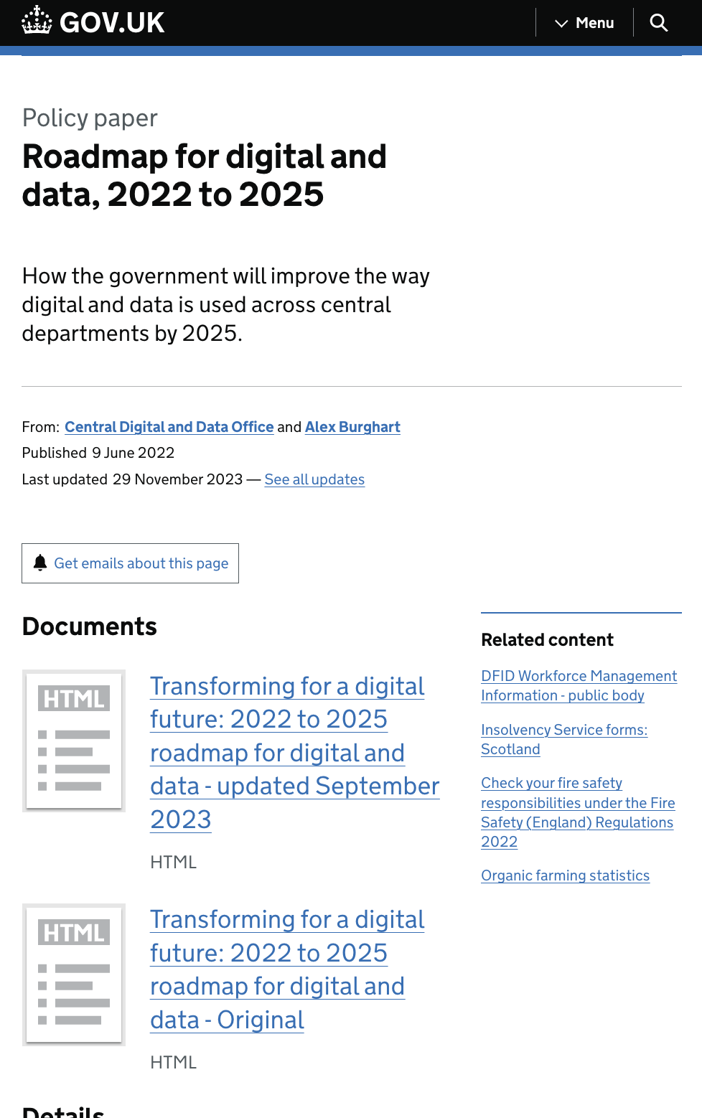
The Secure by Design mandate
Outcome 9 of the Government Cyber Security Strategy
“...ensure that appropriate and proportionate cyber security measures are embedded within the technology government uses, and that the security of digital services is continually assured throughout their lifecycle.”
Commitment 11 of the Roadmap for digital and data, 2022 to 2025
“All new services shall comply with the common approach to Secure By Design”
Notes:
A number of government departments are already following Secure by Design approaches. The need for a consistent approach to Secure by Design across government was initially recognised by the Chief Information Security Officer (CISO) community in 2021.
Secure by Design was cemented as an essential requirement in two key strategies: the Government Cyber Security Strategy and the Roadmap for digital and data, 2022 to 2025. This reflects the fact that the approach is a priority for colleagues in both the Digital and Data and Security professions.
Alongside these two strategic mandates, Secure by Design is also an integral part of the Government Cyber Security Standard and aims to increase the government’s cyber resilience by introducing a common approach for building protective controls in digital services from the very beginning and as these are being delivered.

Slide 5





























Developed in collaboration with
a cross-government working group
and industry partners
Notes:
The approach needs to accommodate a highly diverse group of organisations which vary significantly in size, risk appetite, security practices, and maturity levels. There’s a delicate balance between not being overly prescriptive while still providing sufficient detail for project teams to effectively execute the activities.
It was developed with input from cyber and digital experts working as part of a cross-government working group, and from an industry panel including major government suppliers.
Government Security Group and the National Cyber Security Centre have also been involved, ensuring alignment with other cross-government cyber security initiatives.
Recognising the role of the vendors in Secure by design, an industry panel was established with some of the biggest suppliers to gov (google, AWS, microsoft, capgemini, Accenture) who have been contributing their insights and feedback on the work.
Activities were tested with pilot organisations and user research was conducted with many of the roles across digital and data, project management and security that will be impacted by Secure by Design.
The result is an approach that is practical, flexible, and meets the needs of a diverse range of organisations.

Slide 6
The approach

Slide 7
Key elements
Policy
⬤ ⬤
Mandatory
Monitored via the Cabinet Office digital and technology spend control process and, once new systems services are live, GovAssure.
Principles
⬤ ⬤
Recommended
To be adapted by organisations to reflect their internal structure, processes, governance, culture and resources.
Activities
Resources
Notes:
The approach comprises the Policy, 10 mandatory principles, 21 advisory activities and a number of supporting resources. The activities and resources have been developed to help organisations meet the principles, developed with help from experts from across government.
The first iteration of the cross-government SbD focuses on building strong foundations and clear direction via the SbD principles and core activities that support the implementation of the principles.
The Secure by Design policy sets out the scope of the approach with adoption of the principles being mandatory.

Slide 8
The policy
“All central government departments and arm’s-length bodies (ALBs) shall incorporate effective security practices based on the common government Secure by Design principles when delivering and building digital services and technical infrastructure.” Secure by Design Policy
✓
In scope
New projects and services (and those going through major changes) that are passing through the Cabinet Office digital and technology spend control process.
✗
Not in scope
Digital services that are already in operation or undergoing routine maintenance.
Notes:
The government Secure by Design Policy: Building digital services with security in mind confirms the mandatory requirement for central government organisations to incorporate effective security practices in digital delivery.
The policy requires organisations to build new or make significant changes (need for a business case) to digital services and technical infrastructure in line with the cross-government Secure by Design principles.
The requirements in the policy are specific and positive statements to help organisations understand how to meet the policy and reflect respective Cyber Assessment Framework outcomes. The requirements are directly linked to the published Secure by Design principles.
The policy statement refers to principles and the Secure by Design strategic commitment in the spend controls process refers to the principles with the Secure by Design self assessment tracker structured around the principles

Slide 9
The principles
Read more on security.gov.uk
1
Create responsibility for cyber security risk
6
Design flexible architectures
2
Source secure technology products
7
Minimise the attack surface
3
Adopt a risk-driven approach
8
Defend in depth
4
Design usable security controls
9
Embed continuous assurance
5
Build in detect and respond security
10
Make changes securely
Notes:
The principles reflect security challenges in digital delivery faced by government organisations and are designed to drive certain outcomes.
Recommended activities are associated with each principle. Delivering the activities help you to achieve the principle.
The NCSC secure design principles have been baked into these government principles.

Slide 10
The activities
Read more on security.gov.uk
Manage your security risks
Agreeing a security controls set for your service
Performing a security risk assessment
Responding to and mitigating security risks
Prepare a secure service
Agreeing roles and responsibilities
Sourcing a threat assessment
Assessing the importance of service assets
Maintain continuous assurance
Identifying security resources
Evaluating the security impact of changes
Assessing the effectiveness of security controls
Considering security within the business case
Documenting service assets
Performing threat modelling
Working out the project's security risk appetite
Retiring service components securely
Managing third-party product security risks
Understand the security landscape
Anticipate and respond to vulnerabilities
Tracking Secure by Design progress
Implementing a vulnerability management process
Managing observability
Discovering vulnerabilities
Understanding business objectives and user needs
Understanding cyber security obligations
Includes resource
Notes:
Following the activities will help organisations meet the principles throughout the digital delivery lifecycle
Unlike the principles, the activities are advisory. Organisations should review them to help identify where they might have gaps that need to be addressed
Templates, examples and tools are available to help project and delivery teams implement the activities.
Each activity sets out the what, why, when, who and how. Organisations can tailor them based on their circumstances and needs.

Slide 11

The resources
Preparation Checklist - download
See which requirements your organisation is meeting
Guide to adopting Secure by Design - view
Suggested activities to support implementation
Comms Toolkit - view
Resources to help you inform and engage teams
Self Assessment Tracker - download
Monitor project progress towards meeting principles
Download these at security.gov.uk/guidance/secure-by-design
Example RACI Matrix - download
See which roles should be involved in each activity
Security Controls Taxonomy - download
Industry security standards mapped to CAF outcomes
Notes:
Resources are available to help with the smooth implementation of Secure by Design:
Preparation checklist - designed to help organisations identify potential gaps in their current digital delivery and security practices and capabilities.
Guide to adopting Secure by Design - describes the activities to include in a transition plan, and some of the considerations around them.
Communication Toolkit - including an outline communication plan plus resources such as a factsheet, slides, Q&As and videos.
Self Assessment Tracker - for tracking and evidencing progress with the adoption of Secure by Design within a project.
RACI matrix - an example of who should be involved in particular Secure by Design activities. Job titles and structures differ across government, so this will need to be adapted by project and delivery teams.
Security Controls Taxonomy - helping project teams select appropriate security controls from recognised industry security standards and frameworks (including NIST SP 800-53, NCSC 10 Steps to Cyber Security, and CIS Top 18 Critical Security Controls) as part of risk mitigation activities.

Slide 12
Roles and responsibilities

Slide 13
Secure by Design for senior leaders
Raising awareness, and promoting the benefits, of Secure by Design
Setting the direction for updating processes, policies, standards and governance
Establishing Secure by Design as a shared responsibility across functions (not just Security)
Helping teams to understand their role
CDIOs
CTOs
CISOs
SROs
Integration into the digital strategy and instilling a security conscious culture.
Adding Secure by Design into policies and practices.
Making Secure by Design a key component of service delivery.
Actively supporting delivery teams with technical guidance.
Cultivating a positive security culture across the organisation.
Ensuring cyber security SMEs continuously engage with project delivery teams.
Ensuring Secure by Design is implemented within digital delivery.
Accountable for risk management decisions and direction.
Notes:
There was a great deal of engagement with senior leaders from across digital and data and security as the cross-government Secure by Design approach was developed.
This is an approach that requires culture change, with delivery teams recognising the importance of security.

Slide 14
Who Secure by Design affects
Encouraging everyone involved in digital delivery to prioritise security risk management.
Digital & Data
Project Delivery
Security
Commercial
Product and delivery roles responsible for developing digital services
Development roles responsible for creating secure software
IT operations
User-centred design
Technical architects
Programme and project management roles
Business risk analysts
Assurance teams
Security advisers
Technical security assurance experts
Security risk managers
Security architects
Roles responsible for supplier requirements and contracts
Notes:
Each Secure by Design activity contains information on the roles who may be affected by the implementation and day-to-day operation of Secure by Design.

Slide 15

Your Secure by Design champion(s)
A central point of contact
Promotes the importance of Secure by Design within their organisation
    Drives development and delivery of a transition plan
Your champion does not need to be a cyber security expert. They should have a good understanding of the Secure by Design approach and be able to effectively communicate this to others.
Reports progress to senior leaders and governance forums
    Establishes and runs a Secure by Design working group
Notes:
CDIOs and their equivalents are accountable for the effective adoption of Secure by Design but are unlikely to drive its implementation day-to-day.
That will be down to our Secure by Design champion [NAME], who will liaise closely with a cross-functional working group and stakeholders across the business.
It’s the job of the champion to promote Secure by Design across the organisation and act as a point of contact, both for internal stakeholders but also with the Cabinet Office and the other departments and ALBs implementing this approach.
Crucially, the champion will be leading a gap analysis to identify the key areas for improvement, developing a transition plan and progressing other key implementation activities.
It’s not all on the champion though. Implementing Secure by Design will be a task requiring involvement of individuals and teams from across the organisation.

Slide 16

Your internal working group
Helping to deliver the Secure by Design transition plan
Encouraging collaboration and knowledge sharing
Creating alignment between Secure by Design and organisational goals
Made up of representatives from teams affected by Secure by Design including digital and data, project delivery, cyber security, risk management, assurance and commercial.
Establishing accountability by defining roles and responsibilities
Addressing any issues that arise during implementation
Notes:
The working group includes representatives from the teams affected by Secure by Design.
It will help ensure we have a robust transition plan and each representative, and the team they’re from, will help deliver the activities contained within the plan.
Include information about your working group, who’s involved, who will be involved in future, and key activities the group is working on.

Slide 17
Implementation

Slide 18
Implementation phases and timescales
Group 1
Ministerial departments, ALBs managing government Critical National Infrastructure (CNI) and organisations managing priority government services.
Preparation
4 months
Transition
5 months
Operation
A conditional extension to Mar 2025 may be granted to some organisations.
Secure by Design commitment deadline
2024
Jan
2025
Jan
2026
Jan
Apr
Aug
Jul
Preparation
6 months
Transition
6 months
Operation
Group 2
All remaining ALBs and other central government organisations (such as executive agencies and Treasury funded regulators). These organisations may move faster should they choose to.
Notes:
Central government organisations have been divided into two groups.
Group one organisations are required to implement Secure by Design by the end of 2024 (with a conditional grace period of an extra three months if needed).
Group two organisations are expected to formally start implementation from January 2025. However, they can move quicker than this if they wish.
The Cabinet Office will be discussing progress and challenges with us regularly during our implementation.

Slide 19
Implementation tasks
Preparation
Transition
Operation
Assign accountability to senior leaders
Appoint a Secure by Design champion
Establish an internal working group
Produce an engagement plan
Understand your organisation’s current Secure by Design state
Produce a transition plan
Update policies and processes
Review project pipeline and agree pilot projects
Implement Secure by Design within your pilot projects and capture feedback.
Pilot Self Assessment Tracker and spend control process.
Inform in-scope projects about their obligations
Embed Secure by Design within commercial/procurement processes
Turn the transition plan into an operational plan
Share progress with internal teams and senior leaders
Ensure delivery teams are aware of their responsibilities
Demonstrate that all in-scope projects are meeting Secure by Design principles
Keep internal processes and guidance current
Contribute to the continual improvement of the Secure by Design approach
Notes:
The Cabinet Office consulted widely with departments and ALBs about what an effective implementation might look like. The recommended plan stretches across three phases:
Preparation - building our understanding of the approach, confirming accountabilities, getting a Secure by Design champion and working group in place and plan and do required improvements.
Transition - piloting Secure by Design with a number of projects and developing plans.
Operation - live with Secure by Design rolled out to all in-scope projects.

Slide 20
Q&A

Slide 21

How to stay in touch
Web: security.gov.uk/guidance/secure-by-design
Email: secure-by-design@digital.cabinet-office.gov.uk
Slack: #xgov-secure-by-design-implementation
Security experts at the Cabinet Office are available to support organisations transitioning to Secure by Design.
Blog: cddo.blog.gov.uk/category/cyber-security/
Newsletter: Sign up

